Slide 1
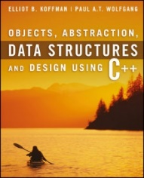
Welcome to
CS 235 Data Structures
Self-balancing Trees (39)
Chapter 11.2 AVL, pgs. 628-643

Slide 2
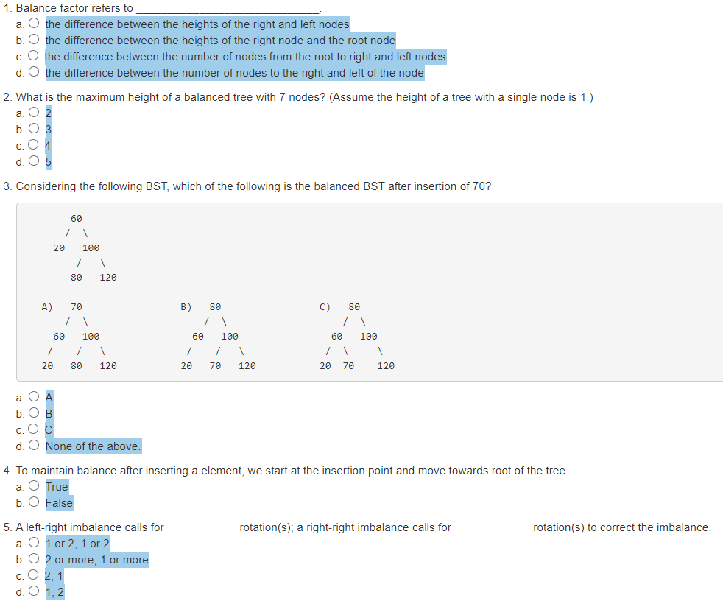
Attendance Quiz #38
BalanceFactor = height(right subtree) – height(left subtree)
A full binary tree of height k can hold 2^{k} - 1 items.
Right-Left (parent balance +2, right child balance -1)
Rotate right around child
Rotate left around parent
Only nodes on the path from insertion point to root node have possibly changed in height.
Left-Right (parent balance -2, left child balance +1)
Rotate left around child
Rotate right around parent
Right-Right (parent balance +2, right child balance +1)
Rotate left around parent

Slide 3
Tip #39: CS 235 and Beyond!
How does CS 235 prepare me for CS 236?
General Programming
Use an IDE (breakpoints, single step, and memory inspect/change.)
Get something working and don't break it.
Create revisions/backups regularly – quickly return to working state.
Program Design
Design/define objects and methods before coding (ie, Database, Relation, Tuple, Predicate, ...)
STL containers, especially vectors, sets, and maps.
ALL objects have toString() and friend << operator.
Debugging
Make small changes and TEST, TEST, TEST.
Use small, targeted test cases.
Maintain a regression test suite.
Don't be a BIG BANG programmer.

Slide 4
Bringing Balance To The World...
Approaches to balancing a tree
Don't balance - May end up with some nodes very deep.
Strict balance - the tree must always be balanced perfectly (complete tree) after every operation – expensive.
Pretty good balance - allow a little out of balance.
Adjust on access - self-adjusting.
Many algorithms exist for keeping binary search trees balanced
Adelson-Velskii and Landis (AVL) trees (height-balanced trees).
Weight-balanced trees.
Red-black trees.
Splay trees and other self-adjusting trees.
The main idea of splay tree is to bring the recently accessed item to root of the tree, this makes the recently searched item to be accessible in O(1).
B-trees and other (e.g. 2-3-4 trees) multiway search trees.

Slide 5
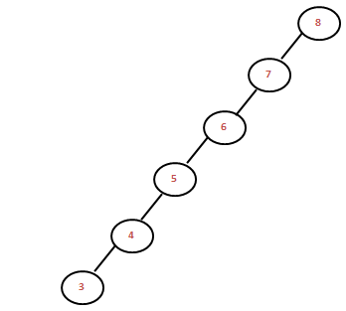
11.2 AVL Trees
Balancing a Left-Left Tree
Balancing a Left-Right Tree
Four Kinds of Critically Unbalanced Trees
Implementing an AVL Tree
Inserting into an AVL Tree
Removal from an AVL Tree
Performance of the AVL Tree
11.1, pgs. 624-628

Slide 6
AVL Trees
In 1962 Georgii M. Adel'son-Vel'skiî (1922-2014) and Evgemii Mikhailovich Landis (1921-1997) developed a self-balancing tree, known by their initials: AVL.
The AVL tree algorithm keeps track of the difference in height of each subtree.
An AVL tree is balanced when the heights of all right and left subtrees are equal (or nearly equal.)
As items are added to (or removed from) a tree, the balance of each subtree from the insertion (or removal) point up to the root is updated.
BalanceFactor = height(right subtree) – height(left subtree)
The absolute difference between the left subtree and right subtree must not be > 1. If it becomes > 1, the subtree is rotated to make it ≤ 1 again.
A subtree is right-heavy if the balance factor > 0.
A subtree is left-heavy if the balance factor < 0.
A subtree is perfectly balanced if the balance factor = 0.

Slide 7
How to Balance Unbalanced Trees
Left-Left (parent balance is -2, left child balance is -1)
Rotate right around parent
root
root
10
0
20
-2
10
-1
40
5
+1
20
0
5
+1
15
7
15
40
7
Left-Right (parent balance -2, left child balance +1)
Rotate left around child
Rotate right around parent
root
20
-2
root
20
-2
root
15
0
10
+1
40
15
-1
40
10
-1
20
0
5
15
+1
10
-1
17
5
17
40
17
5

Slide 8
How to Balance Unbalanced Trees
Right-Right (parent balance +2, right child balance +1)
Rotate left around parent
root
15
+2
root
25
0
10
25
+1
15
0
40
-1
20
40
-1
10
20
30
30
Right-Left (parent balance +2, right child balance -1)
Rotate right around child
Rotate left around parent
root
15
+2
root
15
+2
root
0
20
10
25
-1
10
20
+1
15
0
25
+1
20
-1
40
17
25
+1
10
17
40
17
40

Slide 9
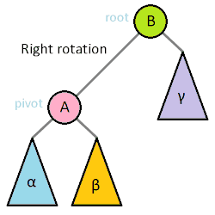
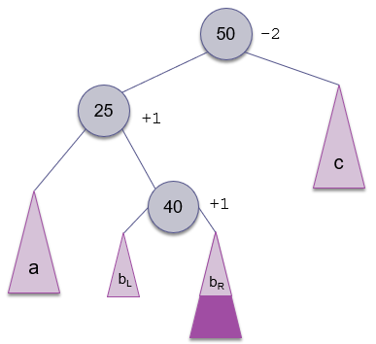
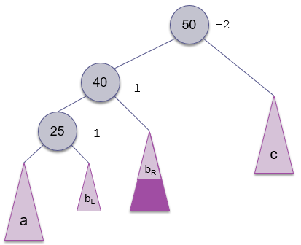
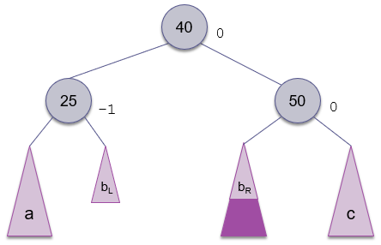
4 Critically Unbalanced Trees
Left-Left (parent balance is -2, left child balance is -1)
Rotate right around parent
Left-Right (parent balance -2, left child balance +1)
Rotate left around child
Rotate right around parent
Right-Right (parent balance +2, right child balance +1)
Rotate left around parent
Right-Left (parent balance +2, right child balance -1)
Rotate right around child
Rotate left around parent

Slide 10
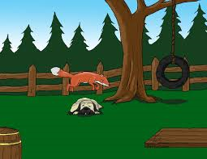
AVL Tree Example
Build an AVL tree from the words:
"The quick brown fox jumps over the lazy dog."

Slide 11
AVL Tree Example
Left-Left (parent balance is -2, left child balance is -1)
Rotate right around parent
Left-Right (parent balance -2, left child balance +1)
Rotate left around child
Rotate right around parent
Right-Right (parent balance +2, right child balance +1)
Rotate left around parent
Right-Left (parent balance +2, right child balance -1)
Rotate right around child
Rotate left around parent
The
0
Insert The

Slide 12
AVL Tree Example
Left-Left (parent balance is -2, left child balance is -1)
Rotate right around parent
Left-Right (parent balance -2, left child balance +1)
Rotate left around child
Rotate right around parent
Right-Right (parent balance +2, right child balance +1)
Rotate left around parent
Right-Left (parent balance +2, right child balance -1)
Rotate right around child
Rotate left around parent
The
+1
Insert quick
quick
0

Slide 13
AVL Tree Example
Left-Left (parent balance is -2, left child balance is -1)
Rotate right around parent
Left-Right (parent balance -2, left child balance +1)
Rotate left around child
Rotate right around parent
Right-Right (parent balance +2, right child balance +1)
Rotate left around parent
Right-Left (parent balance +2, right child balance -1)
Rotate right around child
Rotate left around parent
The
+2
Insert brown
quick
-1
brown
0
The overall tree is right-heavy (Right-Left)
1. Rotate right around the child (quick)

Slide 14
AVL Tree Example
Left-Left (parent balance is -2, left child balance is -1)
Rotate right around parent
Left-Right (parent balance -2, left child balance +1)
Rotate left around child
Rotate right around parent
Right-Right (parent balance +2, right child balance +1)
Rotate left around parent
Right-Left (parent balance +2, right child balance -1)
Rotate right around child
Rotate left around parent
The
+2
brown
+1
quick
0
Rotate right around the child (quick)
Rotate left around the parent (The)

Slide 15
AVL Tree Example
Left-Left (parent balance is -2, left child balance is -1)
Rotate right around parent
Left-Right (parent balance -2, left child balance +1)
Rotate left around child
Rotate right around parent
Right-Right (parent balance +2, right child balance +1)
Rotate left around parent
Right-Left (parent balance +2, right child balance -1)
Rotate right around child
Rotate left around parent
brown
0
Insert fox
The
0
quick
0

Slide 16
AVL Tree Example
Left-Left (parent balance is -2, left child balance is -1)
Rotate right around parent
Left-Right (parent balance -2, left child balance +1)
Rotate left around child
Rotate right around parent
Right-Right (parent balance +2, right child balance +1)
Rotate left around parent
Right-Left (parent balance +2, right child balance -1)
Rotate right around child
Rotate left around parent
brown
+1
Insert fox
The
0
quick
-1
fox
0

Slide 17
AVL Tree Example
Left-Left (parent balance is -2, left child balance is -1)
Rotate right around parent
Left-Right (parent balance -2, left child balance +1)
Rotate left around child
Rotate right around parent
Right-Right (parent balance +2, right child balance +1)
Rotate left around parent
Right-Left (parent balance +2, right child balance -1)
Rotate right around child
Rotate left around parent
brown
+1
Insert jumps
The
0
quick
-1
fox
0

Slide 18
AVL Tree Example
Left-Left (parent balance is -2, left child balance is -1)
Rotate right around parent
Left-Right (parent balance -2, left child balance +1)
Rotate left around child
Rotate right around parent
Right-Right (parent balance +2, right child balance +1)
Rotate left around parent
Right-Left (parent balance +2, right child balance -1)
Rotate right around child
Rotate left around parent
brown
+2
Insert jumps
The
0
quick
-2
fox
+1
The tree is now left-heavy about quick (Left-Right case)
1. Rotate left around the child (fox)
jumps
0

Slide 19
AVL Tree Example
Left-Left (parent balance is -2, left child balance is -1)
Rotate right around parent
Left-Right (parent balance -2, left child balance +1)
Rotate left around child
Rotate right around parent
Right-Right (parent balance +2, right child balance +1)
Rotate left around parent
Right-Left (parent balance +2, right child balance -1)
Rotate right around child
Rotate left around parent
brown
+2
The
0
quick
-2
fox
+1
Rotate left around the child (fox)
jumps
0

Slide 20
AVL Tree Example
Left-Left (parent balance is -2, left child balance is -1)
Rotate right around parent
Left-Right (parent balance -2, left child balance +1)
Rotate left around child
Rotate right around parent
Right-Right (parent balance +2, right child balance +1)
Rotate left around parent
Right-Left (parent balance +2, right child balance -1)
Rotate right around child
Rotate left around parent
brown
+2
The
0
quick
-2
jumps
-1
Rotate left around the child
fox
0
Rotate right around the parent

Slide 21
AVL Tree Example
Left-Left (parent balance is -2, left child balance is -1)
Rotate right around parent
Left-Right (parent balance -2, left child balance +1)
Rotate left around child
Rotate right around parent
Right-Right (parent balance +2, right child balance +1)
Rotate left around parent
Right-Left (parent balance +2, right child balance -1)
Rotate right around child
Rotate left around parent
brown
+1
The
0
jumps
0
fox
0
quick
0

Slide 22
AVL Tree Example
Left-Left (parent balance is -2, left child balance is -1)
Rotate right around parent
Left-Right (parent balance -2, left child balance +1)
Rotate left around child
Rotate right around parent
Right-Right (parent balance +2, right child balance +1)
Rotate left around parent
Right-Left (parent balance +2, right child balance -1)
Rotate right around child
Rotate left around parent
brown
+2
Insert over
The
0
jumps
+1
fox
0
quick
-1
We now have a Right-Right imbalance
over
0

Slide 23
AVL Tree Example
Left-Left (parent balance is -2, left child balance is -1)
Rotate right around parent
Left-Right (parent balance -2, left child balance +1)
Rotate left around child
Rotate right around parent
Right-Right (parent balance +2, right child balance +1)
Rotate left around parent
Right-Left (parent balance +2, right child balance -1)
Rotate right around child
Rotate left around parent
brown
+2
The
0
jumps
+1
fox
0
quick
-1
1. Rotate left around the parent
over
0

Slide 24
AVL Tree Example
Left-Left (parent balance is -2, left child balance is -1)
Rotate right around parent
Left-Right (parent balance -2, left child balance +1)
Rotate left around child
Rotate right around parent
Right-Right (parent balance +2, right child balance +1)
Rotate left around parent
Right-Left (parent balance +2, right child balance -1)
Rotate right around child
Rotate left around parent
jumps
0
Insert the
brown
0
quick
-1
The
0
fox
0
over
0

Slide 25
AVL Tree Example
Left-Left (parent balance is -2, left child balance is -1)
Rotate right around parent
Left-Right (parent balance -2, left child balance +1)
Rotate left around child
Rotate right around parent
Right-Right (parent balance +2, right child balance +1)
Rotate left around parent
Right-Left (parent balance +2, right child balance -1)
Rotate right around child
Rotate left around parent
jumps
0
Insert the
brown
0
quick
0
The
0
fox
0
over
0
the
0

Slide 26
AVL Tree Example
Left-Left (parent balance is -2, left child balance is -1)
Rotate right around parent
Left-Right (parent balance -2, left child balance +1)
Rotate left around child
Rotate right around parent
Right-Right (parent balance +2, right child balance +1)
Rotate left around parent
Right-Left (parent balance +2, right child balance -1)
Rotate right around child
Rotate left around parent
jumps
0
Insert lazy
brown
0
quick
0
The
0
fox
0
over
0
the
0

Slide 27
AVL Tree Example
Left-Left (parent balance is -2, left child balance is -1)
Rotate right around parent
Left-Right (parent balance -2, left child balance +1)
Rotate left around child
Rotate right around parent
Right-Right (parent balance +2, right child balance +1)
Rotate left around parent
Right-Left (parent balance +2, right child balance -1)
Rotate right around child
Rotate left around parent
jumps
+1
Insert lazy
brown
0
quick
-1
The
0
fox
0
over
-1
the
0
lazy
0

Slide 28
AVL Tree Example
Left-Left (parent balance is -2, left child balance is -1)
Rotate right around parent
Left-Right (parent balance -2, left child balance +1)
Rotate left around child
Rotate right around parent
Right-Right (parent balance +2, right child balance +1)
Rotate left around parent
Right-Left (parent balance +2, right child balance -1)
Rotate right around child
Rotate left around parent
jumps
+1
Insert dog.
brown
0
quick
-1
The
0
fox
0
over
-1
the
0
lazy
0

Slide 29
AVL Tree Example
Left-Left (parent balance is -2, left child balance is -1)
Rotate right around parent
Left-Right (parent balance -2, left child balance +1)
Rotate left around child
Rotate right around parent
Right-Right (parent balance +2, right child balance +1)
Rotate left around parent
Right-Left (parent balance +2, right child balance -1)
Rotate right around child
Rotate left around parent
jumps
0
Insert dog
brown
+1
quick
-1
The
0
fox
-1
over
-1
the
0
dog.
0
lazy
0

Slide 30
Insert The
1: The(h1,b0)
Insert quick
1: The(h2,b1)
2: ___ quick(h1,b0)
Insert brown
1: The(h3,b2)
2: ___ quick(h2,b-1)
3: brown(h1,b0) ___
Insert fox
1: The(h4,b3)
2: ___ quick(h3,b-2)
3: brown(h2,b1) ___
4: ___ fox(h1,b0)
Insert jumps
1: The(h5,b4)
2: ___ quick(h4,b-3)
3: brown(h3,b2) ___
4: ___ fox(h2,b1)
5: ___ jumps(h1,b0)
Insert over
1: The(h6,b5)
2: ___ quick(h5,b-4)
3: brown(h4,b3) ___
4: ___ fox(h3,b2)
5: ___ jumps(h2,b1)
6: ___ over(h1,b0)
Insert the
1: The(h6,b5)
2: ___ quick(h5,b-3)
3: brown(h4,b3) the(h1,b0)
4: ___ fox(h3,b2)
5: ___ jumps(h2,b1)
6: ___ over(h1,b0)
Insert lazy
1: The(h7,b6)
2: ___ quick(h6,b-4)
3: brown(h5,b4) the(h1,b0)
4: ___ fox(h4,b3)
5: ___ jumps(h3,b2)
6: ___ over(h2,b-1)
7: lazy(h1,b0) ___
Insert dog.
1: The(h7,b6)
2: ___ quick(h6,b-4)
3: brown(h5,b4) the(h1,b0)
4: ___ fox(h4,b2)
5: dog.(h1,b0) jumps(h3,b2)
6: ___ over(h2,b-1)
7: lazy(h1,b0) ___
AVL
1: The(h7,b6)
2: ___ quick(h6,b-4)
3: brown(h5,b4) the(h1,b0)
4: ___ fox(h4,b2)
5: dog.(h1,b0) jumps(h3,b2)
6: ___ over(h2,b-1)
7: lazy(h1,b0) ___
Insert The
1: The(h1,b0)
Insert quick
1: The(h2,b1)
2: ___ quick(h1,b0)
Insert brown
Right-Left heavy
Rotate Right "quick"
Rotate Left "The"
1: brown(h2,b0)
2: The(h1,b0) quick(h1,b0)
Insert fox
1: brown(h3,b1)
2: The(h1,b0) quick(h2,b-1)
3: fox(h1,b0) ___
Insert jumps
Left-Right heavy
Rotate Left "fox"
Rotate Right "quick"
1: brown(h3,b1)
2: The(h1,b0) jumps(h2,b0)
3: fox(h1,b0) quick(h1,b0)
Insert over
Right-Left heavy
Rotate Left "brown"
1: jumps(h3,b0)
2: brown(h2,b0) quick(h2,b-1)
3: The(h1,b0) fox(h1,b0) over(h1,b0) ___
Insert the
1: jumps(h3,b0)
2: brown(h2,b0) quick(h2,b0)
3: The(h1,b0) fox(h1,b0) over(h1,b0) the(h1,b0)
Insert lazy
1: jumps(h4,b1)
2: brown(h2,b0) quick(h3,b-1)
3: The(h1,b0) fox(h1,b0) over(h2,b-1) the(h1,b0)
4: lazy(h1,b0) ___
Insert dog.
1: jumps(h4,b0)
2: brown(h3,b1) quick(h3,b-1)
3: The(h1,b0) fox(h2,b-1) over(h2,b-1) the(h1,b0)
4: dog.(h1,b0) ___ lazy(h1,b0) ___
AVL
1: jumps(h4,b0)
2: brown(h3,b1) quick(h3,b-1)
3: The(h1,b0) fox(h2,b-1) over(h2,b-1) the(h1,b0)
4: dog.(h1,b0) ___ lazy(h1,b0) ___

Slide 31
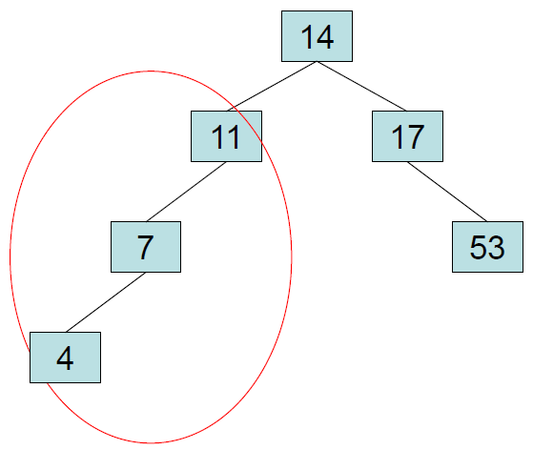
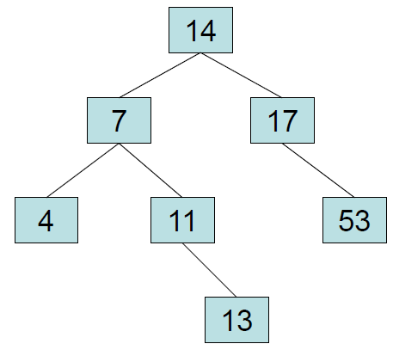
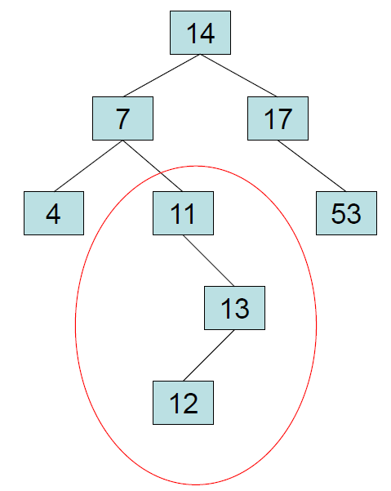
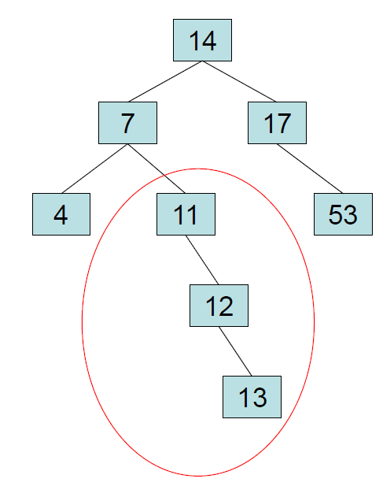
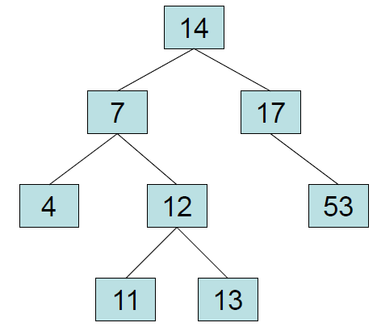
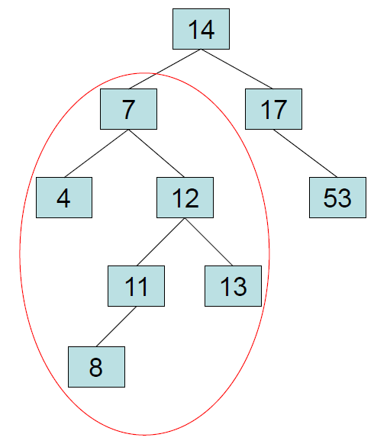
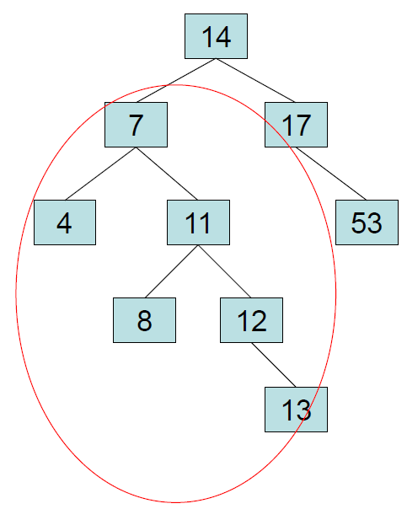
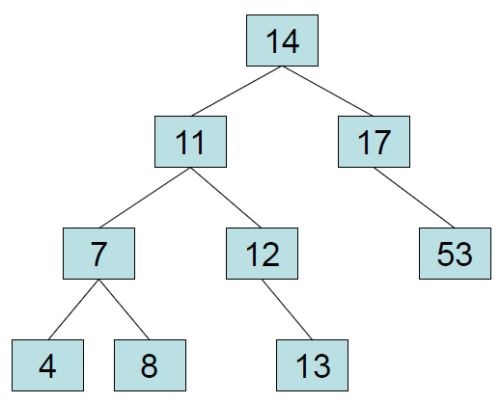
Insert the following into an AVL tree: 14, 17, 11, 7, 53, 4, 13, 12, 8
Left-Left (parent balance is -2, left child balance is -1)
Rotate right around parent
Left-Right (parent balance -2, left child balance +1)
Rotate left around child
Rotate right around parent
Right-Right (parent balance +2, right child balance +1)
Rotate left around parent
Right-Left (parent balance +2, right child balance -1)
Rotate right around child
Rotate left around parent

Slide 32
Insertion and Deletion of a Node
The easiest way to keep a tree balanced is never to let it get out of balance.
Update the height of a node as you return along the insertion path to the root node.
If any node's balance factor is less that -1 or greater than 1, rebalance immediately.
With insertions, only one rebalance (single or double rotation) may possibly be needed to rebalance the tree.
The binary search tree removal function can be adapted for removal from an AVL tree.
Update the height of a node as you return along the delete left path to the root node.
If a node's balance factor is outside the threshold, rebalance to restore balance.
Each recursive return can result in a further need to rebalance (deletion only).

Slide 33
Performance of the AVL Tree
A fully balanced tree guarantees that all left and right subtrees (recursively) have the same height.
AVL trees use a weaker balance definition:
For any node in an AVL tree, the height of the left and right nodes differs by a most 1.
The tree may contain some holes.
Since each subtree is kept close to balanced, the AVL has expected O(log n).
In the worst case (which is rare) an AVL tree can be 1.44 times the height of a full binary tree that contains the same number of items.
Ignoring constants, this still yields O(log n) performance.
Empirical tests show that on average log_{2.}n + 0.25 comparisons are required to insert the nth item into an AVL tree – close to insertion into a corresponding complete binary search tree.
2

Slide 34
Pros and Cons of AVL Trees
Argument for AVL trees:
Search is O(log n) since AVL trees are always balanced.
Insertion and deletions are also O(log n).
The height balancing adds no more than a constant factor to the speed of insertion.
Arguments against using AVL trees:
Difficult to program & debug; more space for balancing information (balance factor, increase, decrease, height.)
Rebalancing costs time.
Not well suited for searches in large database systems on disk - other tree structures (e.g. B-trees) are better.
May be OK to have O(n) for a single operation if total run time for many consecutive operations is fast, but multiple operations would benefit from optimized access (e.g. Splay trees).

Slide 35
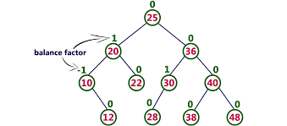
Lab 11 - AVL
Lab 11: AVL Trees

Slide 36
AVL Trees
In 1962 G.M. Adel'son-Vel'skiî and E.M. Landis developed a self-balancing tree, known by their initials: AVL.
The AVL tree algorithm keeps track of the difference in height of each subtree.
An AVL tree is balanced when the heights of all right and left subtrees are equal (or nearly equal.)
As items are added to (or removed from) a tree, the balance of each subtree from the insertion (or removal) point up to the root is updated.
BalanceFactor = height(right subtree) – height(left subtree)
The absolute difference between the left subtree and right subtree must not be > 1. If it becomes > 1, the subtree is rotated to make it ≤ 1 again.
A subtree is right-heavy if the balance factor > 0.
A subtree is left-heavy if the balance factor < 0.
A subtree is perfectly balanced if the balance factor = 0.

Slide 37
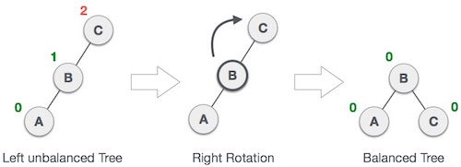
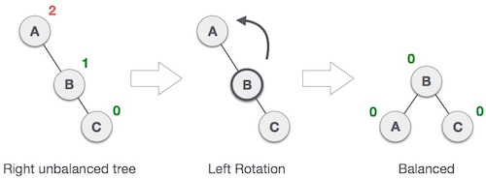
AVL Trees
A node's "heaviness" is derived from its balance factor.
A subtree is right-heavy if the balance factor is greater than zero.
If the balance factor is less than zero then the subtree is left-heavy.
If the balance factor is zero then the subtree is perfectly in balance.
If a node's balance factor gets out of the range -1 to +1, the subtree is rotated according to its balance factor to bring it back into range.
Left-Left (parent balance is -2, left child balance is -1)
Rotate right around parent
Left-Right (parent balance -2, left child balance +1)
Rotate left around child
Rotate right around parent
Right-Right (parent balance +2, right child balance +1)
Rotate left around parent
Right-Left (parent balance +2, right child balance -1)
Rotate right around child
Rotate left around parent

Slide 38
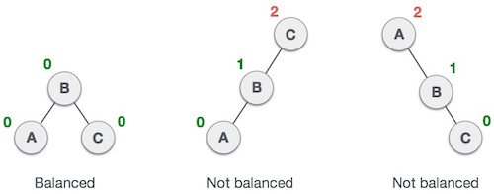
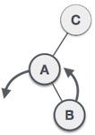
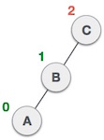
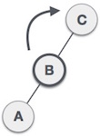
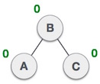
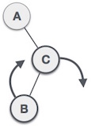
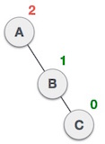
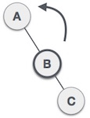

Slide 39
Lab Guidelines
There are multiple correct methods for rebalancing nodes in an AVL tree. (Each method may result in a different AVL tree.)
You should follow the algorithms presented in the course text, starting on page 634.
For example, when a Node is left-imbalanced and its left child is balanced, treating it as a Left-Right case will produce a "balanced" tree, but it would be different from the expected output. You should treat this as a Left-Left case.
When removing a node with two children, replace it with its in-order-predecessor, or "greatest left child."
You should remove nodes from the AVL tree in the same manner used in the BST lab.
Remember to disallow duplicate entries and handle the case where the element to be removed is not in the tree.
You are required to make your AVL a template class.
You may not use any Standard Library data structures.

Slide 40
AVL Commands
COMMAND | DESCRIPTION | OUTPUT
INT | Instantiates AVL object for subsequent commands. | True
STRING | Instantiates AVL object for subsequent commands. | True
add <data> | Add data node to AVL. Return false if duplicate. | True False
remove <data> | Remove node from AVL. Return false if not found. | True False
clear | Delete all nodes from the AVL. | True
print | Print AVL (using insertion operator) in level-order. | Level-order listing of AVL.
size | Output the number of nodes in the AVL. | Number of AVL nodes
find <data> | Find and display node in AVL. Return "Found" or "Not Found". | Found Not Found!

Slide 41
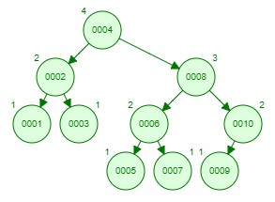
Example
INT true
add 1 true
add 2 true
add 3 true
add 1 false
print:
1: 2
2: 1 3
add 4 true
add 5 true
add 6 true
add 10 true
print:
1: 4
2: 2 6
3: 1 3 5 10
add 8 true
add 7 true
add 9 true
print:
1: 4
2: 2 8
3: 1 3 6 10
4: 5 7 9 _
INT
add 1
add 2
add 3
add 1
print
add 4
add 5
add 6
add 10
print
add 8
add 7
add 9
print

Slide 42
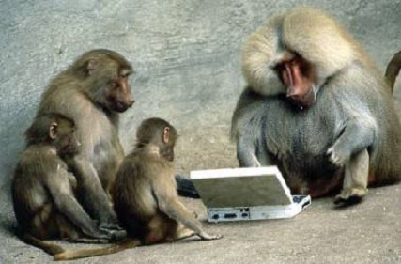
Be Safe

